Slide 1
STAT 5940: Tutorial 2
Seth Beckett

Slide 2
CONTENTS
Introduction
Process
Roadblocks
Conclusion

Slide 3
INTRODUCTION
At Discover Financial Services, I work on the Enterprise Data Stewardship team. We are in charge of helping ensure compliance throughout the enterprise by training and accounting for data stewards, or those who are responsible for the production and consumption of data.

Slide 4
Excel sheet update automation
Leveraging the use of Python to automate a process of manual excel updates, saving DFS 50+ hours per year!

Slide 5
Process
Create Imitation Data
Data Preprocessing
Data Wrangling

Slide 6
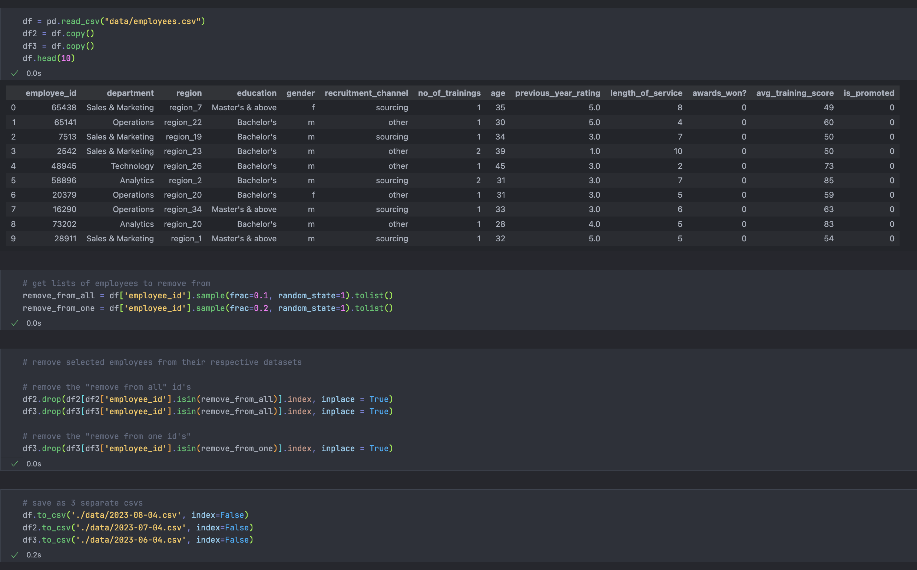
Process: Data Creation
Discover is extremely secure and strict about using and copying code and/or company data, so I first had to create dummy data that was similar to what I used
Steps:
Get fake HR data from Kaggle (https://www.kaggle.com/datasets/arashnic/hr-ana)
Read in data as pandas dataframe
Make copies, representing different months
Randomly remove employees from different months to imitate employees leaving the company.

Slide 7
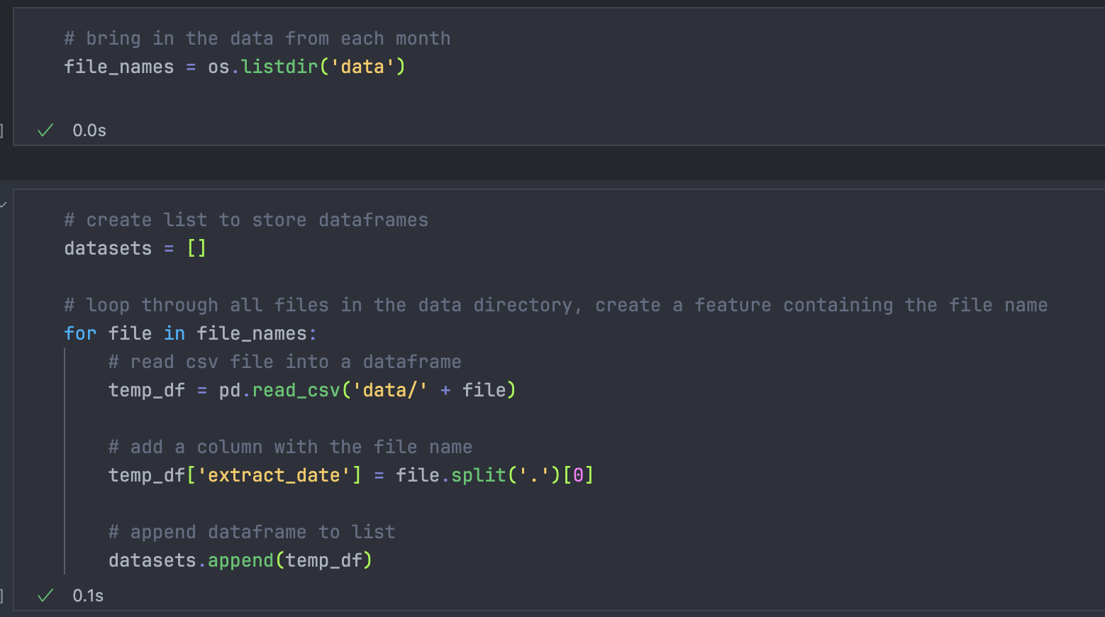
Process: Data Preprocessing
Before we can format the data how we will need it in the future, we first need to join it all together.
Steps:
Convert all the HR CSV files into dataframes
Create a column “extract date” that comes from the file name for each file (this will be used later)
Store the dataframes in a list

Slide 8
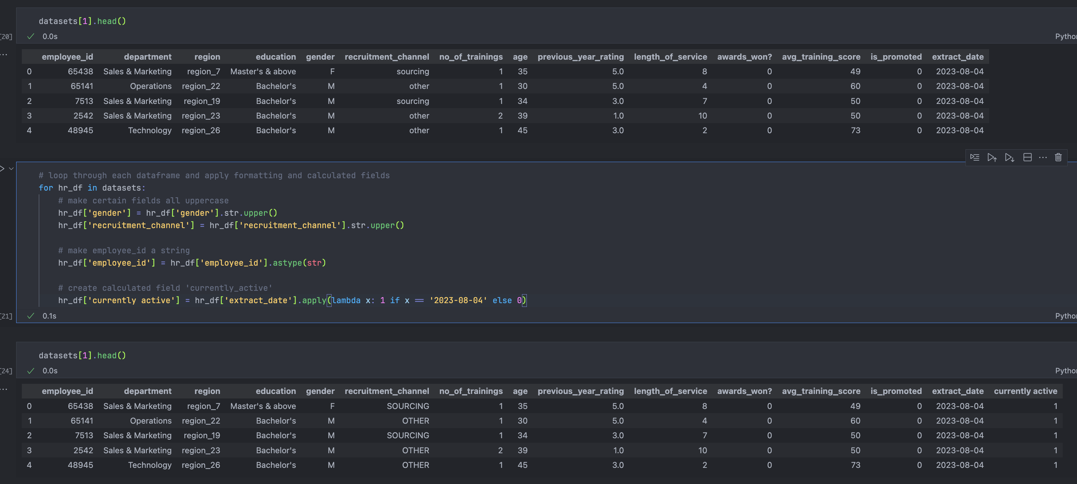
Process: Data Wrangling
Now we format the data how in the way that the system expects them to be input.
Steps:
Change ‘gender’ and ‘recruitment_channel’ columns to be uppercase
Ensure that ‘employee_id’ is a string
Create a ‘currently_active’ indicator that tells whether an employee is still working for the company

Slide 9
Roadblocks
Technical
Other
Trying to do this in both Tableau Flow and Python proved to be difficult (team knows Tableau flow, but running it in Python is much faster)
Team is nontechnical, so any changes I made or code I created had to be meticulously documented
Balancing this project with other projects and responsibilities

Slide 10
Conclusion
While this is just a simulated version of what I actually did, creating this flow in Python and integrating it with our systems decreased the processing time of HR data by 10-20x. Now my team (which is not the most technical team) can leverage this Python script to ensure data integrity and reduce manual labor.

Slide 11

Appendix
Link to Github
https://github.com/sethbeckett/stat5940-tutorial1

